Slide 1
Computer Vision
Part 2: Classical Object Detection
ADF – Start 08:30

Slide 2

Agenda
Part 1: Object Localization
Part 2: Classical Object Detection
Part 3: Two-Stage Object Detection
Part 4: One-Stage Object Detection
Computer Vision

Slide 3
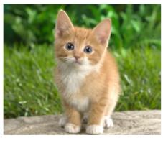
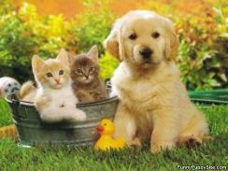
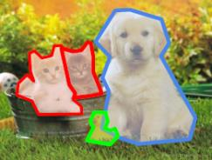
Computer Vision Tasks
Classification
+ Localization
Instance
Segmentation
Classification
Object Detection
Computer Vision

Slide 4
How to solve Detection?
Computer Vision

Slide 5
Detection as Regression?
Computer Vision

Slide 6
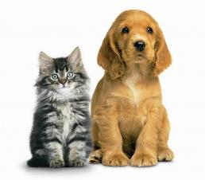
Detection as Regression
DOG, (x, y, w, h)
CAT, (x, y, w, h)
= 8 numbers
Computer Vision

Slide 7
Detection as Regression
DOG, (x, y, w, h)
CAT, (x, y, w, h)
CAT (x, y, w, h)
DUCK (x, y, w, h)
= 16 numbers
Computer Vision

Slide 8
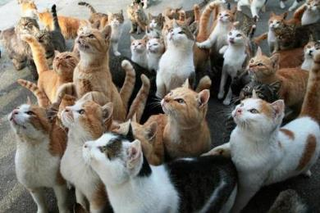
Detection as Regression
CAT, (x, y, w, h)
CAT, (x, y, w, h)
CAT, (x, y, w, h)
…..
CAT, (x, y, w, h)
= many numbers
Problem: Need variable sized outputs
We cannot use simple regression head
Computer Vision

Slide 9
Detection as Classification (Back using Sliding Window)
Computer Vision

Slide 10
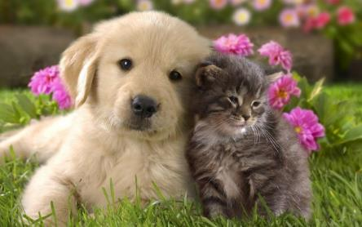
Back to Sliding Window
YES
CAT? NO
DOG? NO
Computer Vision

Slide 11
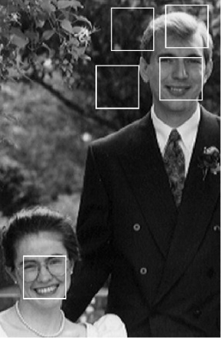
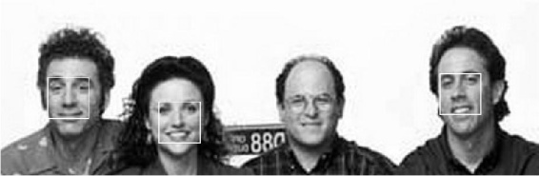
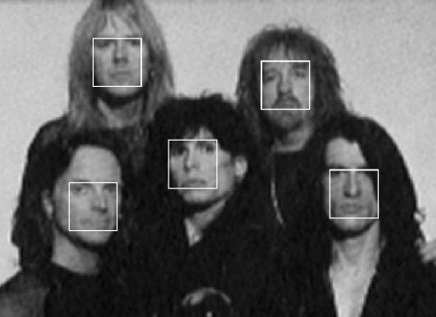
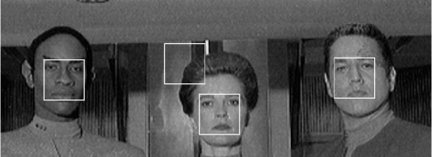
Single Class Detection: Face Detection
Classical approach
*that’s pretty much what I did back in the day
Computer Vision

Slide 12
Single Class Detection : Human Detection
Classical approach
Computer Vision

Slide 13

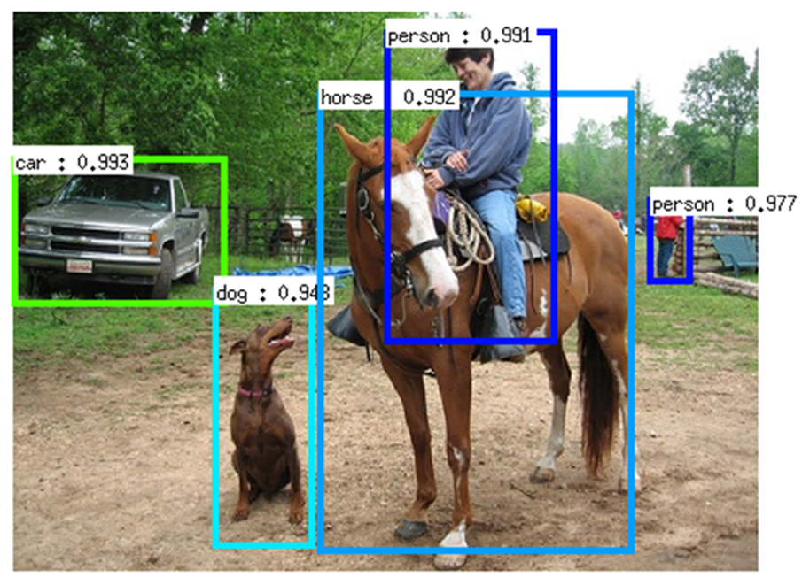
Modern Object Detection
Generic, Multi-class, all at once
Computer Vision

Slide 14
Object Detection – Datasets
 | PASCAL VOC (2010) | ImageNet Detection (ILSVRC 2014) | MS-COCO (2014)
Number of classes | 20 | 200 | 80
Number of images train + val | ~20k | ~470k | ~120k
Mean objects per image | 2.4 | 1.1 | 7.2
Computer Vision

Slide 15
Evaluating Detection
Computer Vision

Slide 16
Evaluation Metrics
Intersection Over Union
Precision and Recall
Mean Average Precision
Computer Vision

Slide 17
Intersection over Union
Computer Vision

Slide 18
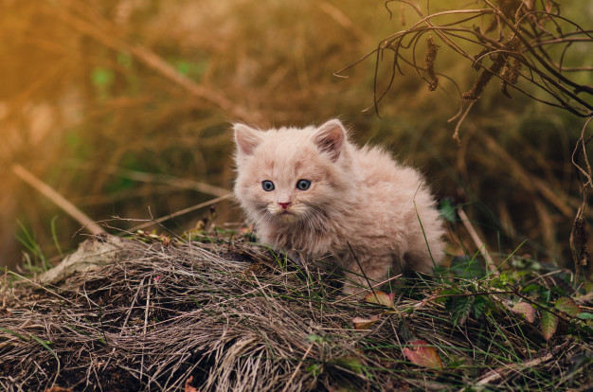

Intersection over Union
“Jaccard similarity” or “Jaccard index”
Prediction
Ground Truth
Computer Vision

Slide 19
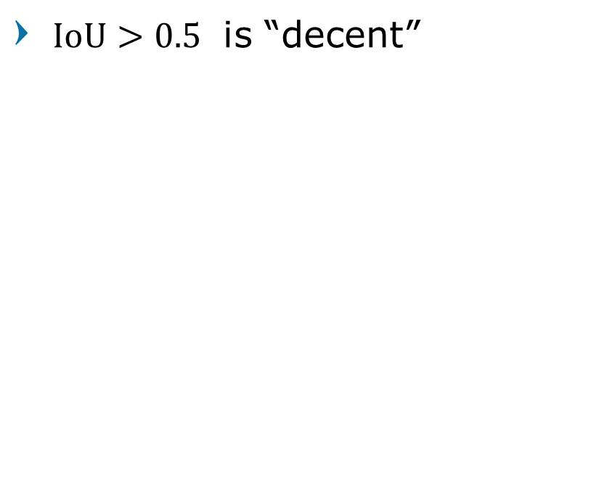
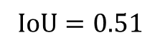
Intersection over Union
$\text{IoU}>0.5$ is “decent”
Prediction
$$\text{IoU}=0.51$$
Ground Truth
Computer Vision

Slide 20
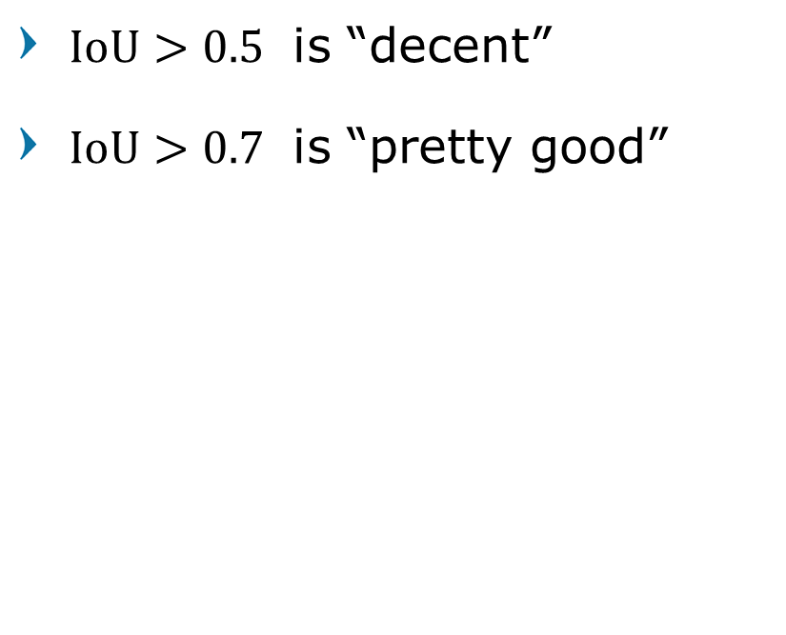
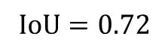
Intersection over Union
$\text{IoU}>0.5$ is “decent”
$\text{IoU}>0.7$ is “pretty good”
Prediction
$$\text{IoU}=0.72$$
Ground Truth
Computer Vision

Slide 21
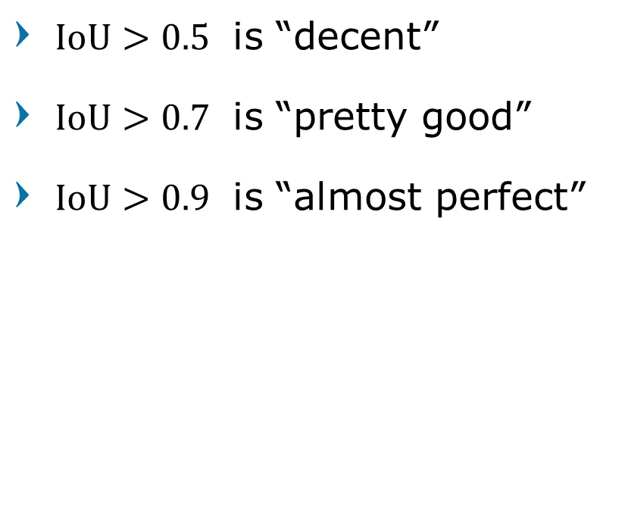
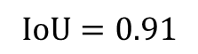
Intersection over Union
$\text{IoU}>0.5$ is “decent”
$\text{IoU}>0.7$ is “pretty good”
$\text{IoU}>0.9$ is “almost perfect”
Prediction
$$\text{IoU}=0.91$$
Ground Truth
Computer Vision

Slide 22
Precision and Recall
Computer Vision

Slide 23
Positives and Negatives
Prediction
True Positives
IoU > threshold (usually 0.5)
Correct class
Ground Truth
TP
Cat
Cat
IoU>0.5
Computer Vision

Slide 24
Positives and Negatives
Prediction
False Positives
Ground Truth
TP
FP
Cat
Bird
Cat
Cat
Cat
Cat
Cat
Cat
IoU>0.5
Wrong class
IoU<0.5
No Overlap
Computer Vision

Slide 25
Positives and Negatives
Prediction
False Negatives
Ground Truth
TP
FP
FN
Cat
Bird
Cat
Cat
Cat
Cat
Cat
Cat
Cat
IoU>0.5
Wrong class
IoU<0.5
No Overlap
No Prediction
Computer Vision

Slide 26
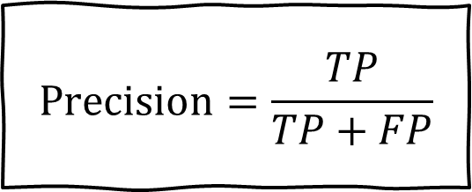
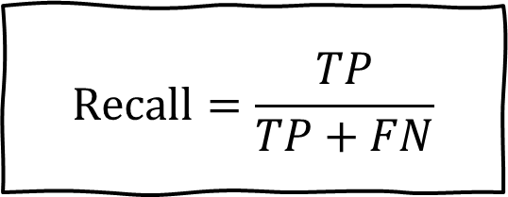
Precision and Recall
Precision
How many positive predictions were correct compared to all prediction
Recall
How much positive data was recognized
$$\text{Precision}=\frac{TP}{TP+FP}$$
$$\text{Recall}=\frac{TP}{TP+FN}$$
Computer Vision

Slide 27
Mean Average Precision
Computer Vision

Slide 28
Object Detection – Evaluation
Mean average precision (mAP)
Compute average precision (AP) separately for each class
Average over class
True Positive
Has IoU with a ground-truth box greater than some threshold
Usually th=0.5 (or written as mAP@0.5)
Computer Vision

Slide 29
Average Precision
Area under Precision vs Recall Curve
Sort all predicted boxes (for all images) According to scores
For each k (location) in the list Compute recall and precision
Computer Vision

Slide 30
Average Precision of a single class detection
Sort each detection (highest to lowest score)
Loop for all detection
All cat detections sorted by score
0.99
0.95
0.9
0.5
0.1
All ground-truth cat boxes
Computer Vision

Slide 31
Average Precision of a single class detection
Sort each detection (highest to lowest score)
If it matches some GT box with IoU > 0.5,
mark it as positive and eliminate the GT
Otherwise mark it as negative
Plot a point on PR Curve
AP = area under PR curve
All cat detections sorted by score
0.99
0.95
0.9
0.5
0.1
All ground-truth cat boxes
Computer Vision

Slide 32
Average Precision of a single class detection
Step-by-step example
All cat detections sorted by score
Precision =1/1 =1.0
Recall =1/3 =0.33
0.99
0.95
0.9
0.5
0.1
Match: IoU > 0.5
All ground-truth cat boxes
Precision
Recall
1.0
Computer Vision

Slide 33
Average Precision of a single class detection
Step-by-step example
All cat detections sorted by score
Precision =2/2 =1.0
Recall =2/3 =0.67
0.99
0.95
0.9
0.5
0.1
Match: IoU > 0.5
All ground-truth cat boxes
Precision
Recall
1.0
Computer Vision

Slide 34
Average Precision of a single class detection
Step-by-step example
All cat detections sorted by score
Precision =2/3 =0.67
Recall =2/3 =0.67
0.99
0.95
0.9
0.5
0.1
No Match > IoU with GT
All ground-truth cat boxes
Precision
Recall
1.0
Computer Vision

Slide 35
Average Precision of a single class detection
Step-by-step example
All cat detections sorted by score
Precision =2/4 =0.5
Recall =2/3 =0.67
0.99
0.95
0.9
0.5
0.1
No Match > IoU with GT
All ground-truth cat boxes
Precision
Recall
1.0
Computer Vision

Slide 36
Average Precision of a single class detection
Step-by-step example
All cat detections sorted by score
Precision =2/5 =0.6
Recall =3/3 =1.0
0.99
0.95
0.9
0.5
0.1
Match: IoU > 0.5
All ground-truth cat boxes
Precision
Recall
1.0
Computer Vision

Slide 37
Average Precision of a single class detection
AP = area under PR curve
All cat detections sorted by score
0.99
0.95
0.9
0.5
0.1
All ground-truth cat boxes
Precision
Cat AP = 0.86
Recall
1.0
Computer Vision

Slide 38

Mean Average Precision of an Object Detector
mAP = average of AP for each category
For “COCO mAP”: Compute mAP@thresh for each IoU threshold (0.5, 0.55, 0.6, …, 0.95) and take average
Car AP = 0.65
Cat AP = 0.86
Dog AP = 0.80
mAP@0.5 = 0.77
mAP@0.5 = 0.77
mAP@0.55 = 0.71
mAP@0.6 = 0.65
…
mAP@0.95 = 0.2
COCO mAP = 0.4
Computer Vision

Slide 39
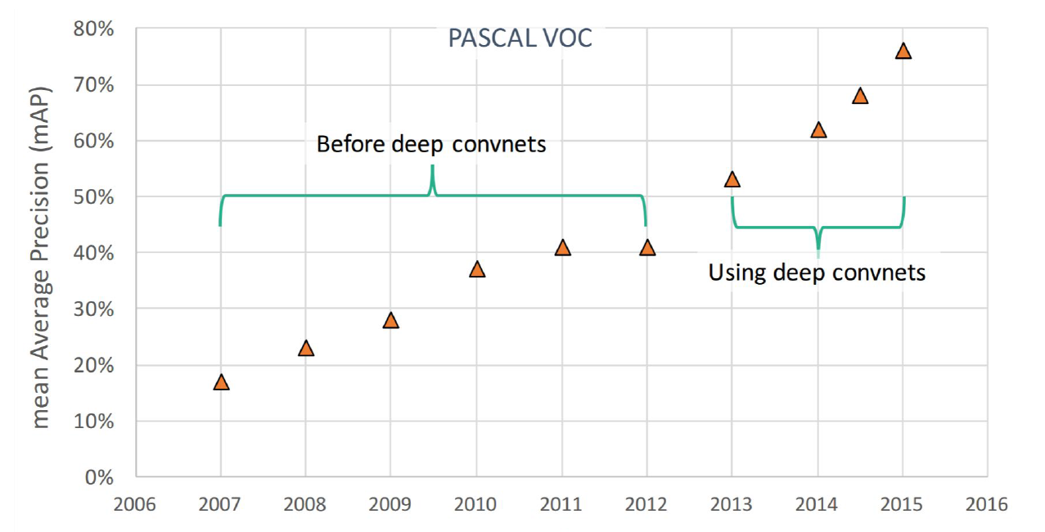
Impact of Deep Learning
Computer Vision

Slide 40
Object Detection: Classical Approach
Computer Vision

Slide 41
Classical Approach
Scan all possible locations
Extract features
Classify features
Post-processing
Computer Vision

Slide 42
Classical Approach
Scan all possible locations
Extract features
Classify features
Post-processing
Problem:
Window size is fixed
Objects are various sized (scale)
Computer Vision

Slide 43
Classical Approach
Scan all possible locations
Down-scale image
Extract features
Classify features
Post-processing
Computer Vision

Slide 44
Classical Approach
Scan all possible locations
Down-scale image
Keep shrinking
Extract features
Classify features
Post-processing
Computer Vision

Slide 45
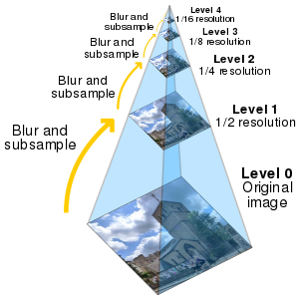
Gaussian Pyramid
Computer Vision

Slide 46
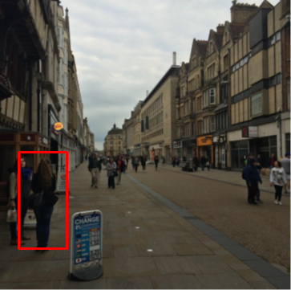
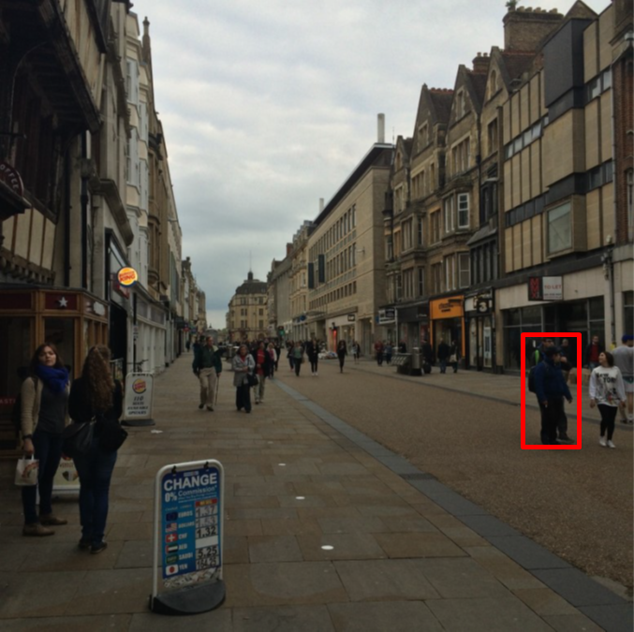
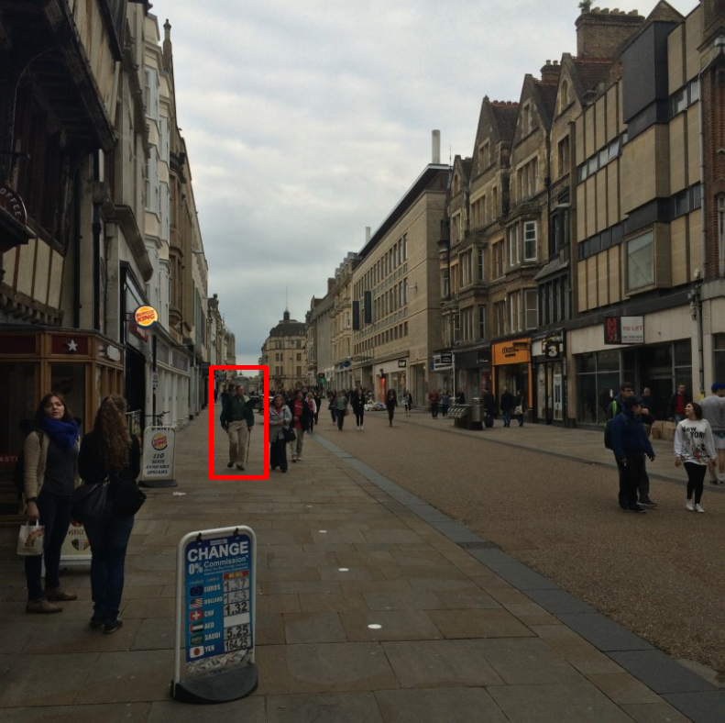
Classical Approach
Scan all possible locations
Use gaussian pyramid
Extract features
Classify features
Post-processing
Computer Vision

Slide 47
Classical Approach
Scan all possible locations
Use gaussian pyramid
Extract features
Classify features
Post-processing
Problem?
Each window classified separately
Computer Vision

Slide 48
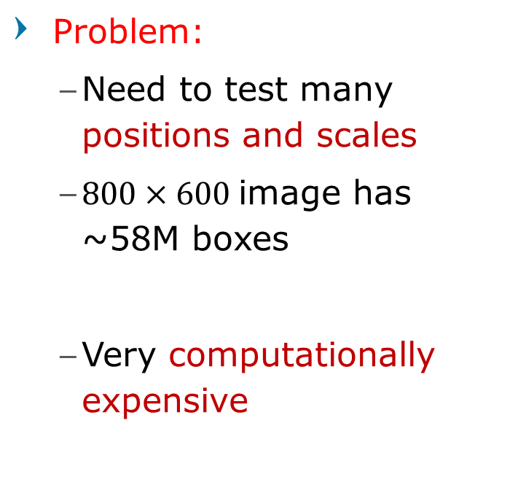
Classical Approach
Problem:
Need to test many positions and scales
$800×600$image has ~58M boxes
Very computationally expensive
Each window classified separately
Computer Vision

Slide 49
Region Proposal
Computer Vision

Slide 50

Region Proposals
Find small set of boxes/regions that are likely to contain objects
Often based on heuristics: e.g. look for “blob-like” image regions
“Class-agnostic” object detector that fast to run
Computer Vision

Slide 51
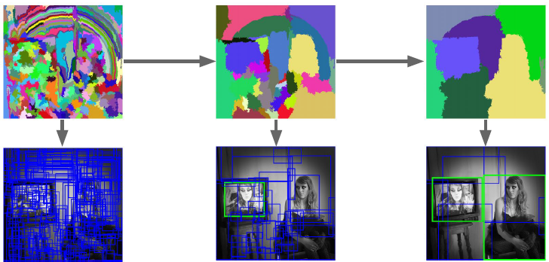
Selective Search
Bottom-up segmentation, merging regions at multiple scales
Gives ~2000 region proposals in a few seconds on CPU
Uijlings et al, “Selective Search for Object Recognition”, IJCV 2013
Computer Vision

Slide 52
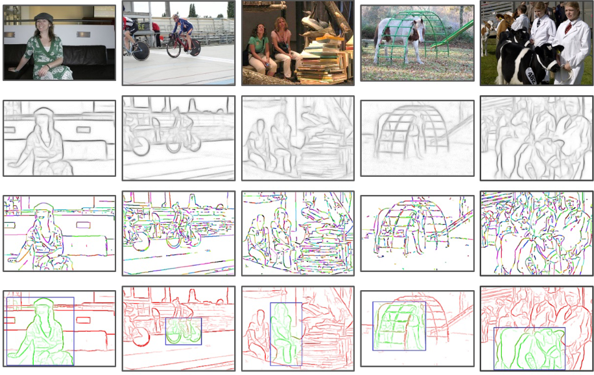
Edge Boxes
Detect edges, group them into contours
Rank each window based on number of contours in window
[Zitnick & Dollar, 2014]
Computer Vision

Slide 53
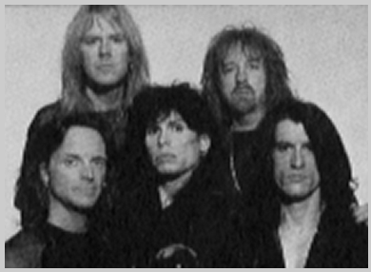
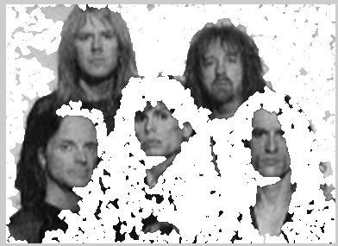
Background Segmentation
Even a simple segmentation could work
*Hey, I did something similar to that too
Computer Vision

Slide 54
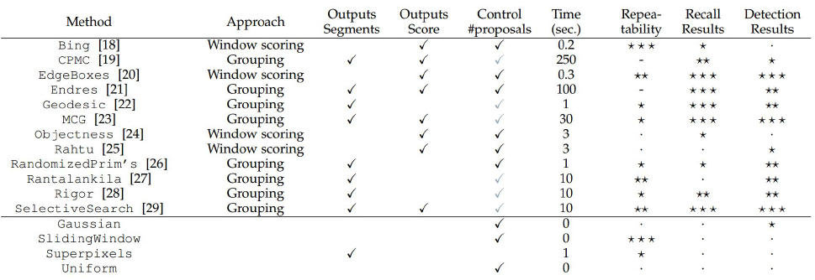
Region Proposal Methods
Hosang et al, “What makes for effective detection proposals?”, PAMI 2015
Computer Vision

Slide 55
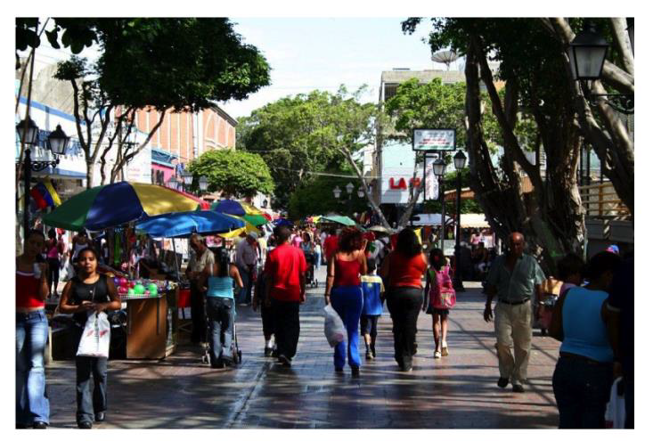
Classical Approach
Scan all possible locations
Use gaussian pyramid
Use region proposal
Extract features
Classify features
Post-processing
Computer Vision

Slide 56
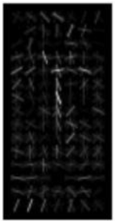
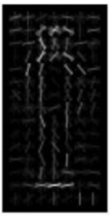
Classical Approach
Scan all possible locations
Use gaussian pyramid
Use region proposal
Extract features
Classify features
Post-processing
Computer Vision

Slide 57
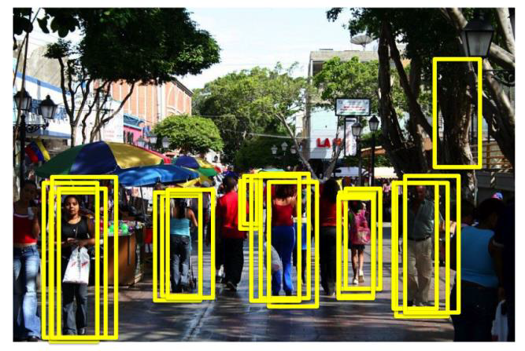
Classical Approach
Scan all possible locations
Use gaussian pyramid
Use region proposal
Extract features
Classify features
Post-processing
Computer Vision

Slide 58
Classical Approach
Scan all possible locations
Use gaussian pyramid
Use region proposal
Extract features
Classify features
Post-processing
Non-max suppression
Computer Vision

Slide 59
Non-Maximum Suppression
Computer Vision

Slide 60
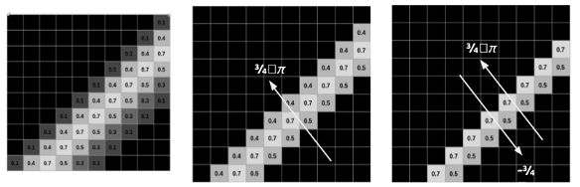
From Canny Edge Detector
Computer Vision

Slide 61
Non-Maximum Suppression
Iterate over all detection
Select next highest-scoring box
Find overlap with all other boxes
Eliminate lower-scoring boxes with IoU > threshold (e.g. 0.7)
Run on each class independently
Computer Vision

Slide 62
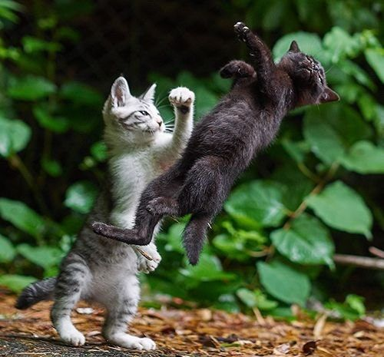
Non-Max Suppression
P(cat)=0.9
P(cat)=0.75
P(cat)=0.7
P(cat)=0.8
Computer Vision

Slide 63
Non-Max Suppression
P(cat)=0.9
IoU(🟥, 🟩) = 0.78
Remove 🟩
P(cat)=0.75
P(cat)=0.7
P(cat)=0.8
Computer Vision

Slide 64
Non-Max Suppression
P(cat)=0.9
IoU(🟥, 🟩) = 0.78
Remove 🟩
IoU(🟥, 🟧) = 0.07
IoU(🟥, 🟨) = 0.05
P(cat)=0.75
P(cat)=0.7
Computer Vision

Slide 65
Non-Max Suppression
P(cat)=0.9
IoU(🟧, 🟨) = 0.74
Remove 🟨
P(cat)=0.75
P(cat)=0.7
Computer Vision

Slide 66
Non-Max Suppression
P(cat)=0.9
Result
P(cat)=0.75
Computer Vision

Slide 67

Non-Max Suppression Problem
NMS may eliminate ”good” boxes when objects are highly overlapping…
no good solution
Computer Vision

Slide 68
Classical Approach
Scan all possible locations
Use gaussian pyramid
Use region proposal
Extract features
Classify features
Post-processing
Non-max suppression
Computer Vision

Slide 69
Classical Approach
Scan all possible locations
Use gaussian pyramid
Use region proposal
Extract features
Classify features
Post-processing
Non-max suppression
Computer Vision

Slide 70
Classical Approach
Scan all possible locations
Use gaussian pyramid
Use region proposal
Extract features
Classify features
Post-processing
Non-max suppression
Computer Vision

Slide 71
Classical Approach
Scan all possible locations
Use gaussian pyramid
Use region proposal
Extract features
Classify features
Post-processing
Non-max suppression
Computer Vision

Slide 72
Classical Approach
Scan all possible locations
Use gaussian pyramid
Use region proposal
Extract features
Classify features
Post-processing
Non-max suppression
Computer Vision

Slide 73
Classical Approach
Scan all possible locations
Use gaussian pyramid
Use region proposal
Extract features
Classify features
Post-processing
Non-max suppression
Computer Vision

Slide 74

Break, Question?
Computer Vision

